Slide 1
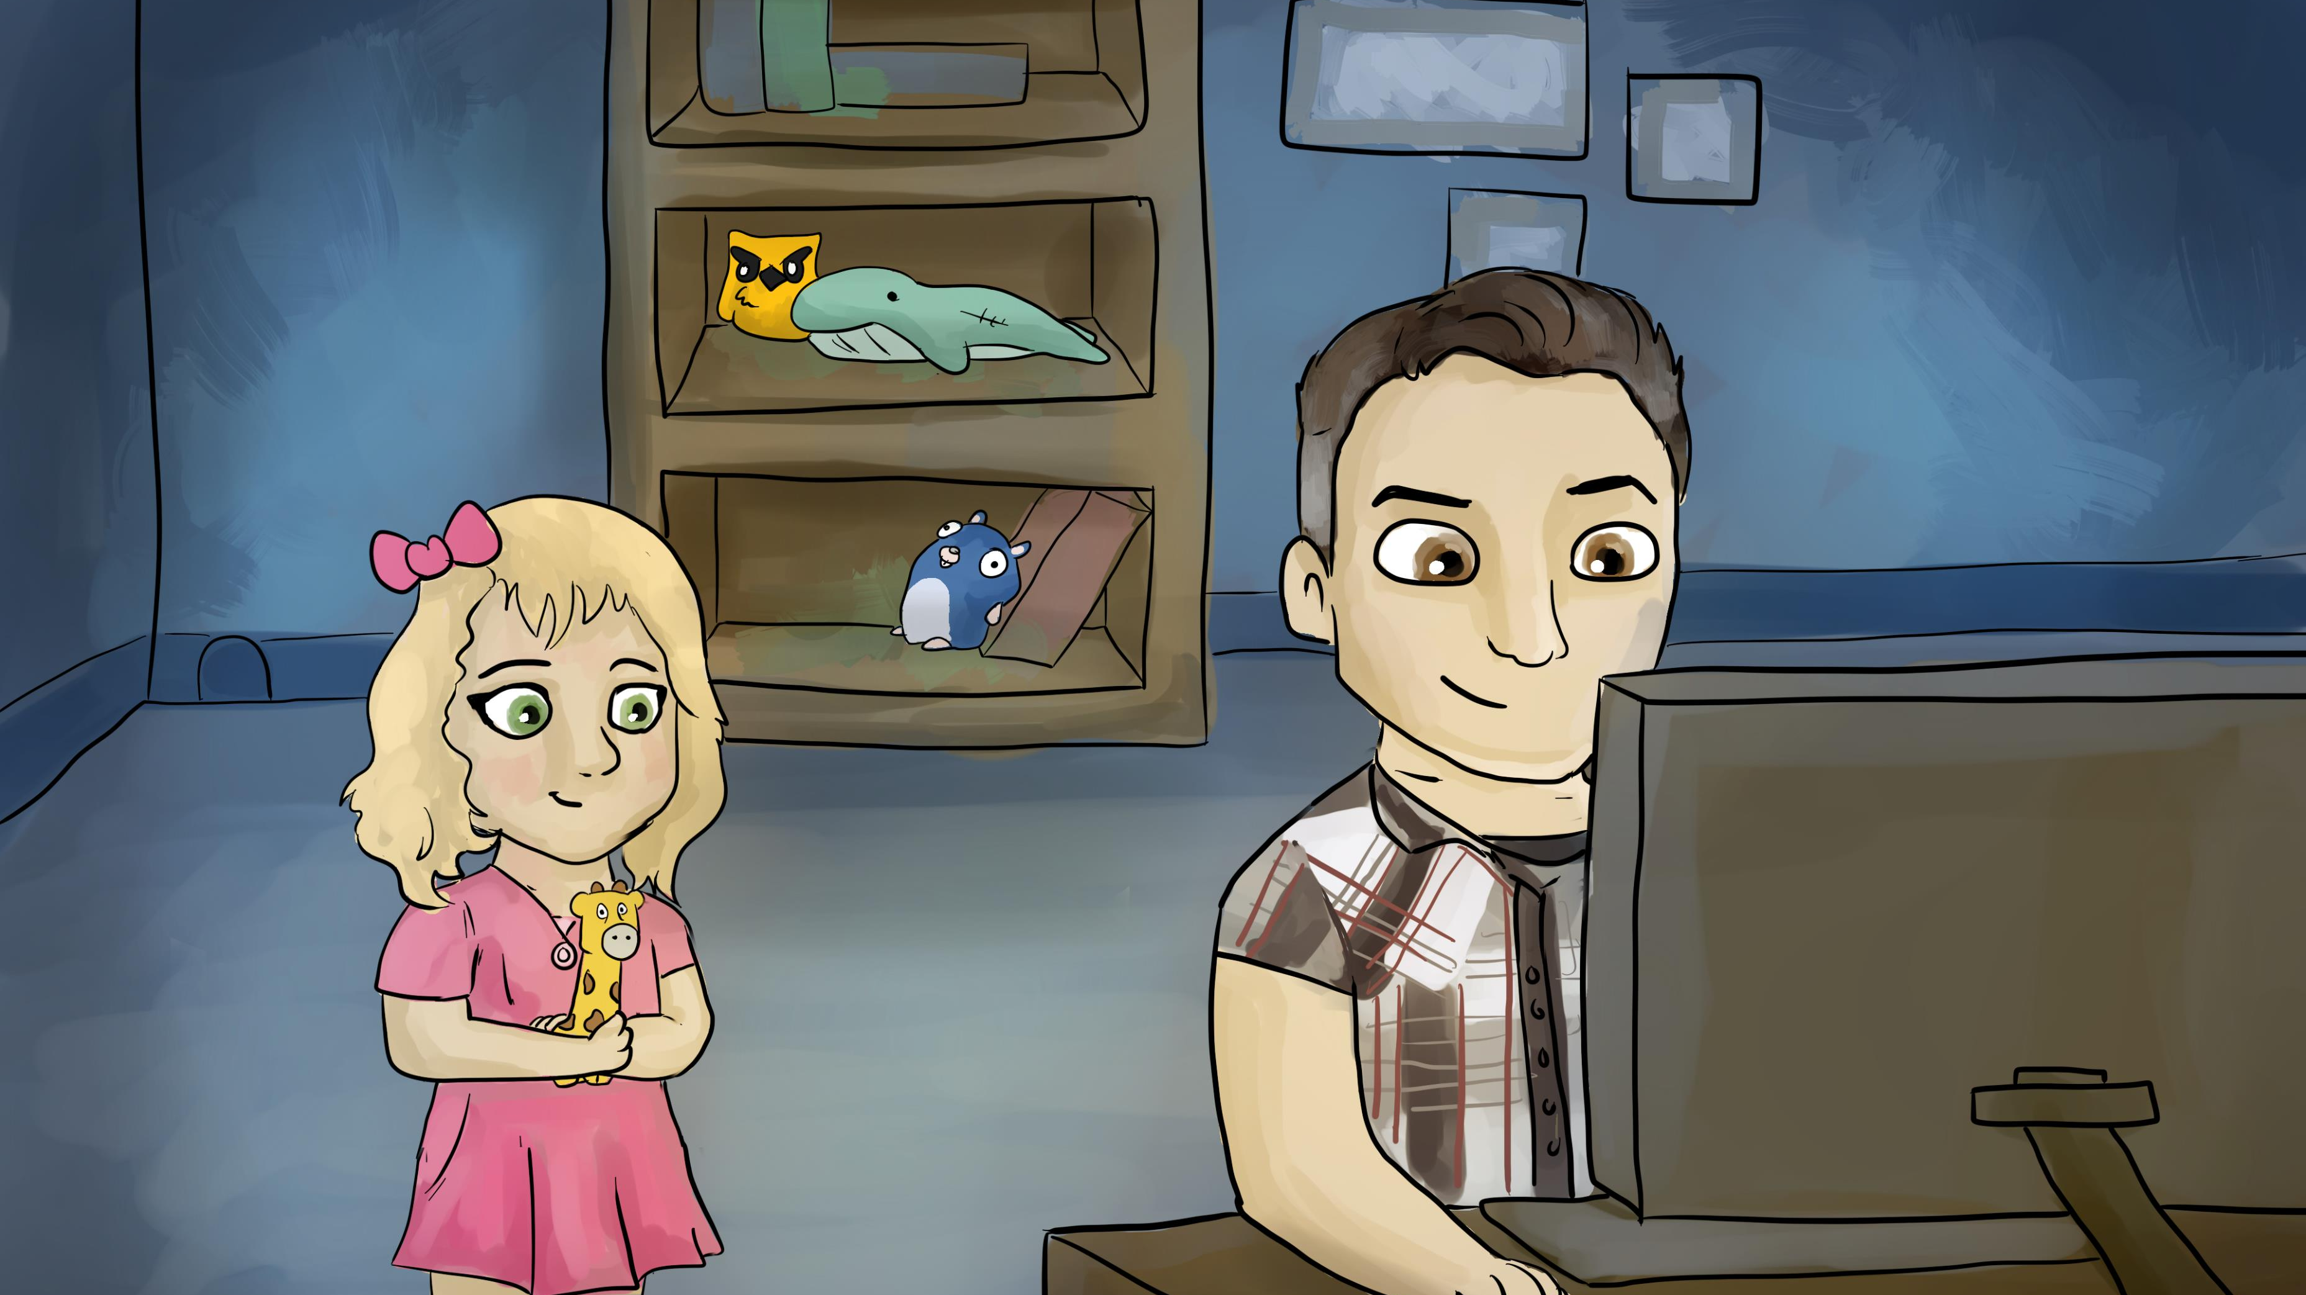
Notes:
One day my daughter Zoe came to me and said, “Daddy, what is that owl doing on your shelf in your office? What does it have to do with your work?”
I said, in my short-sleeved dress shirt, which I would never wear, “Well, Zoe, that’s Captain Kube! Sit down, and I will tell you a story about him.”

Slide 2
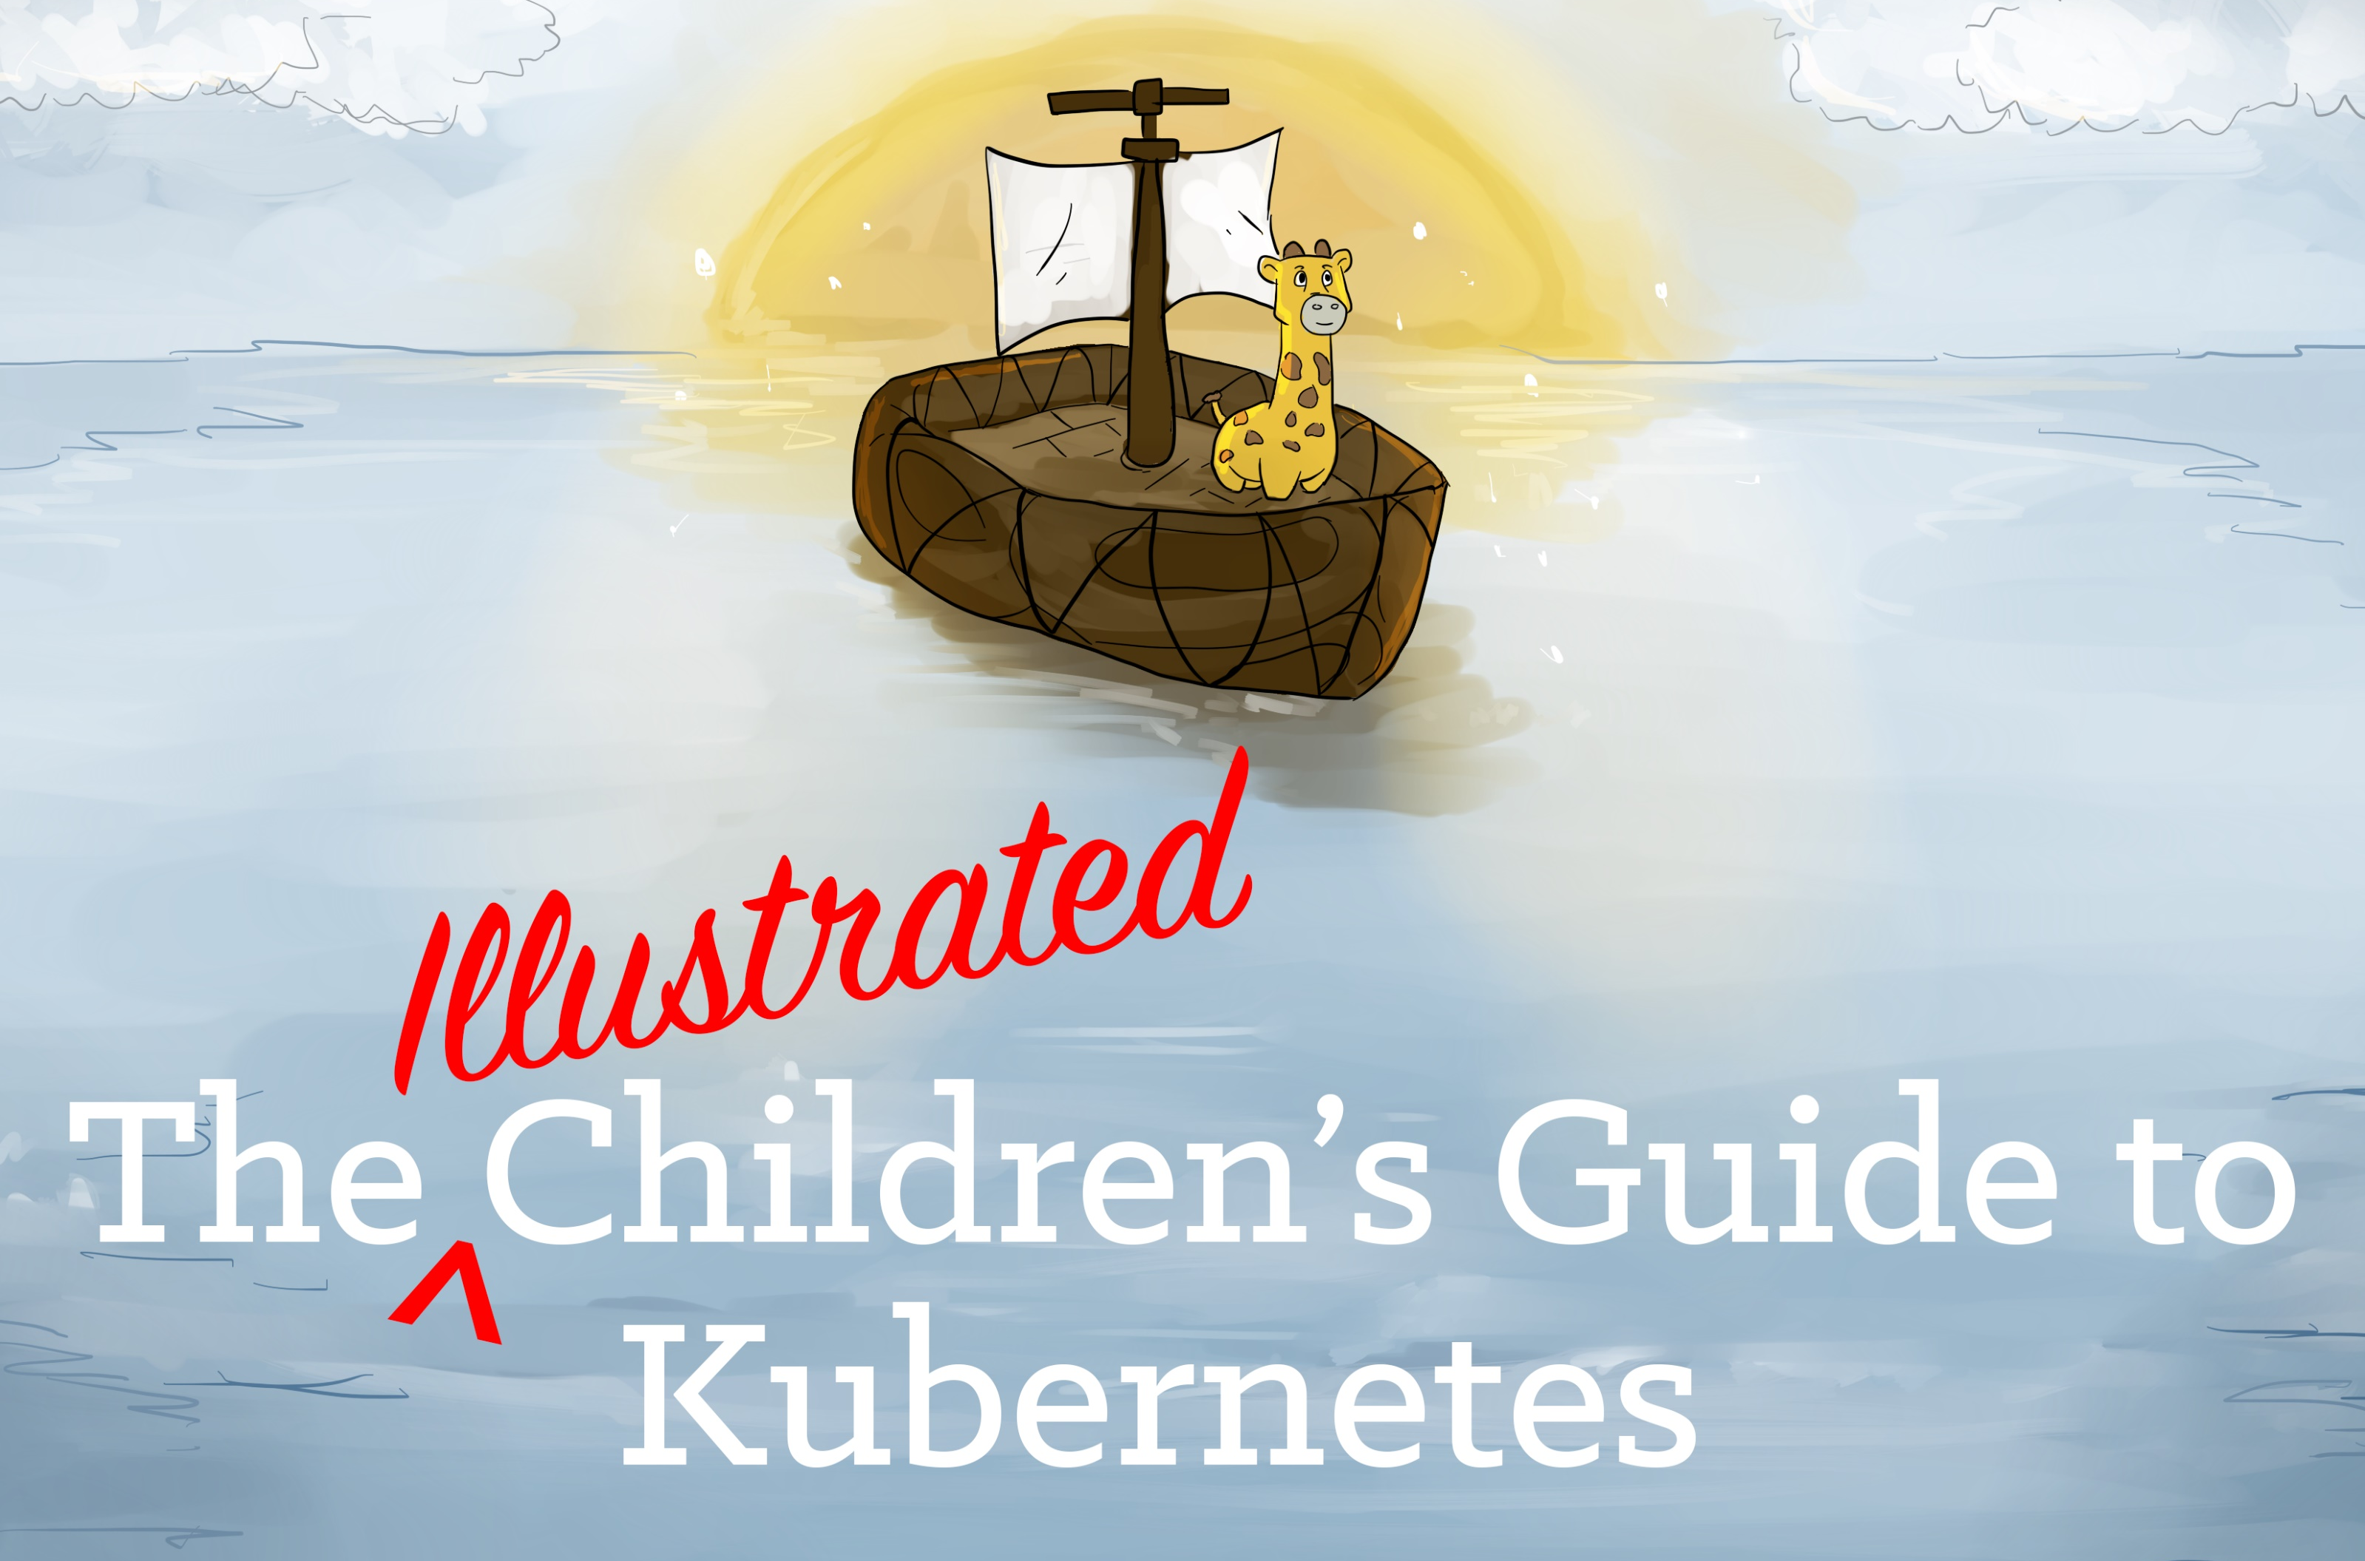
For More Phippy, visit:
https://phippy.io
Notes:
The Illustrated Children’s Guide to Kubernetes
Originally written by Matt Butcher
Story modified by me, Frank Lesniak
Illustrated by Bailey Beougher (“Bow-er”)
Designed by Karen Chu
Illustration of Goldie is based on the Go Gopher designed by Renee French

Slide 3
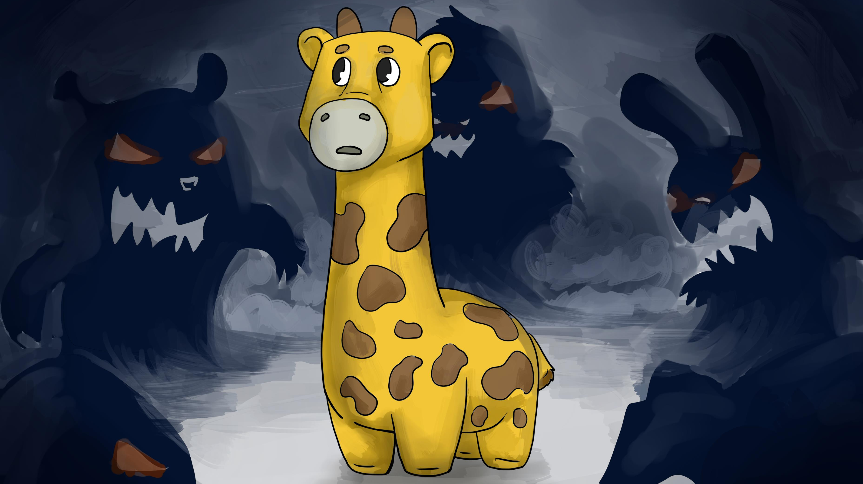
Notes:
Once upon a time, there was an app named Phippy, and she looked just like your little giraffe there. She was a simple app written in PHP, and she had only one page. She lived on a hosting provider, and she shared her environment with scary other apps that she did not know and with whom she did not care to associate. She wished that she had an environment of her own---just her and a webserver that she could call home.

Slide 4
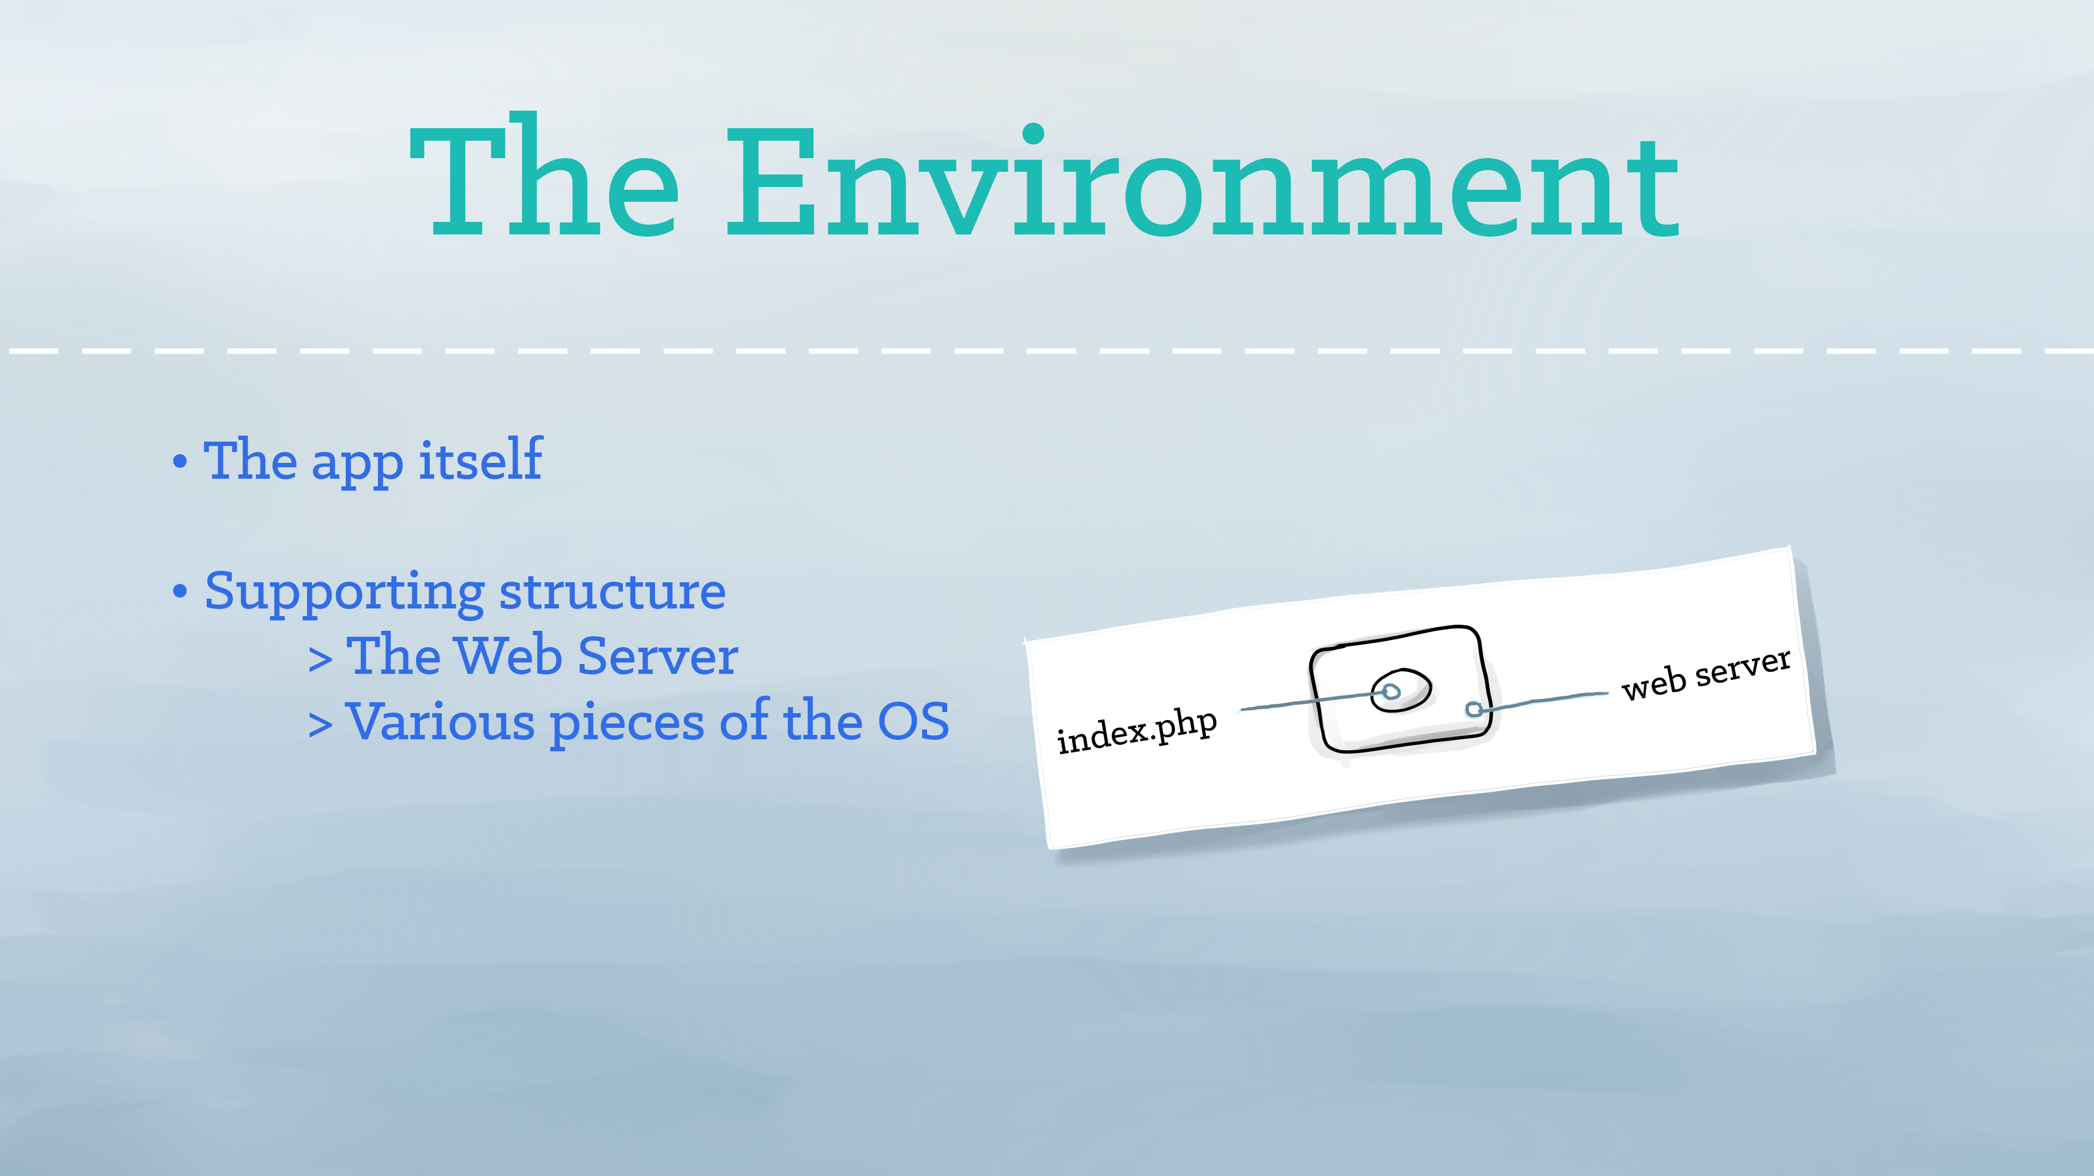
Notes:
An app has an environment that it relies upon to run. For a PHP app like Phippy, that environment might include a web server, a read-only file system, and the PHP engine itself.

Slide 5
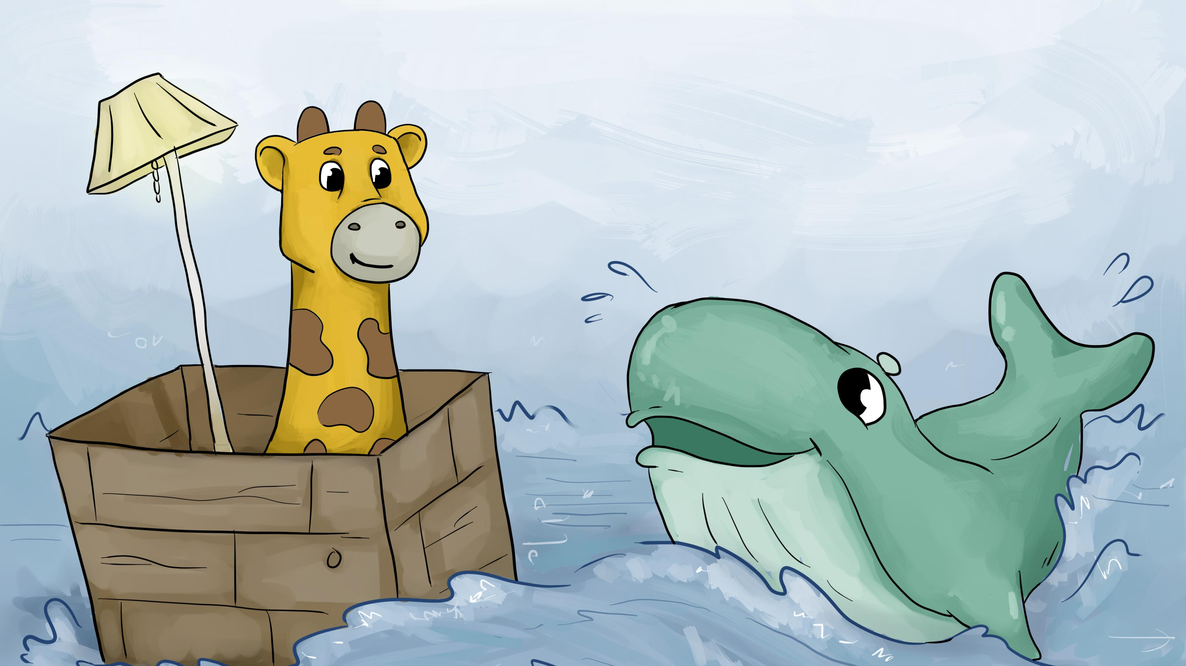
Notes:
One day, a kindly whale came along. He suggested that little Phippy might be happier living in a container, and so she moved. The container was nice, but it was a little bit like having a fancy living room floating in the middle of the ocean.

Slide 6
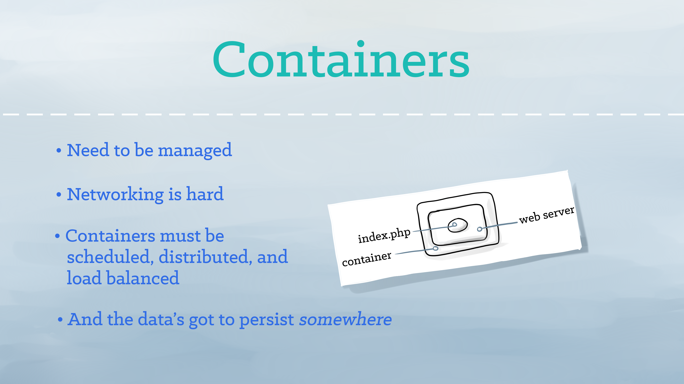
Notes:
A container provides an isolated place for an app like Phippy to live, together with its environment. However, isolated containers often need to be managed and connected to the external world. Shared file systems, networking, scheduling, load balancing, and distribution are all challenges.

Slide 7
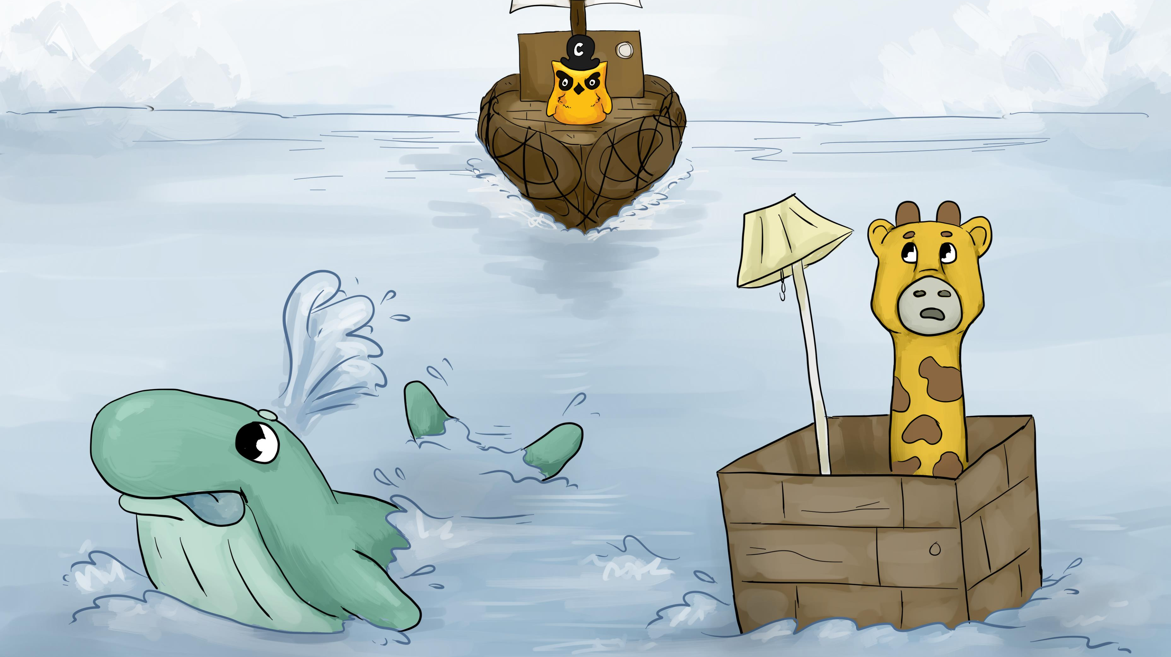
Notes:
The whale shrugged his flippers. “Sorry, kid,” he said, then disappeared beneath the ocean’s surface. But, before Phippy could even begin to despair, a captain appeared on the horizon, piloting a gigantic ship. The ship was made of dozens of rafts all lashed together. But from the outside, it looked like one huge boat.

Slide 8
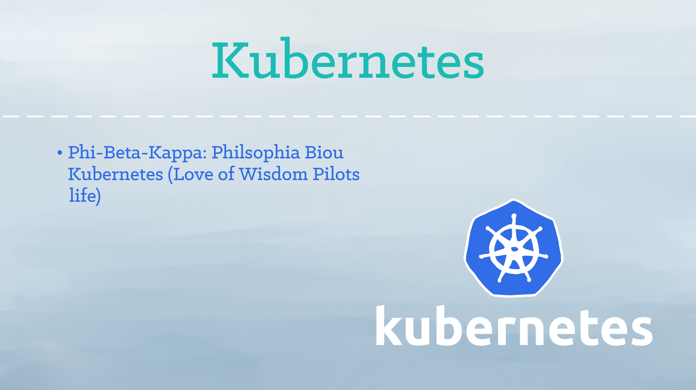
Notes:
Kubernetes is the Greek word for a ship’s captain. Led by Google, the Kubernetes project focuses on building a robust platform for running thousands of containers in production.

Slide 9
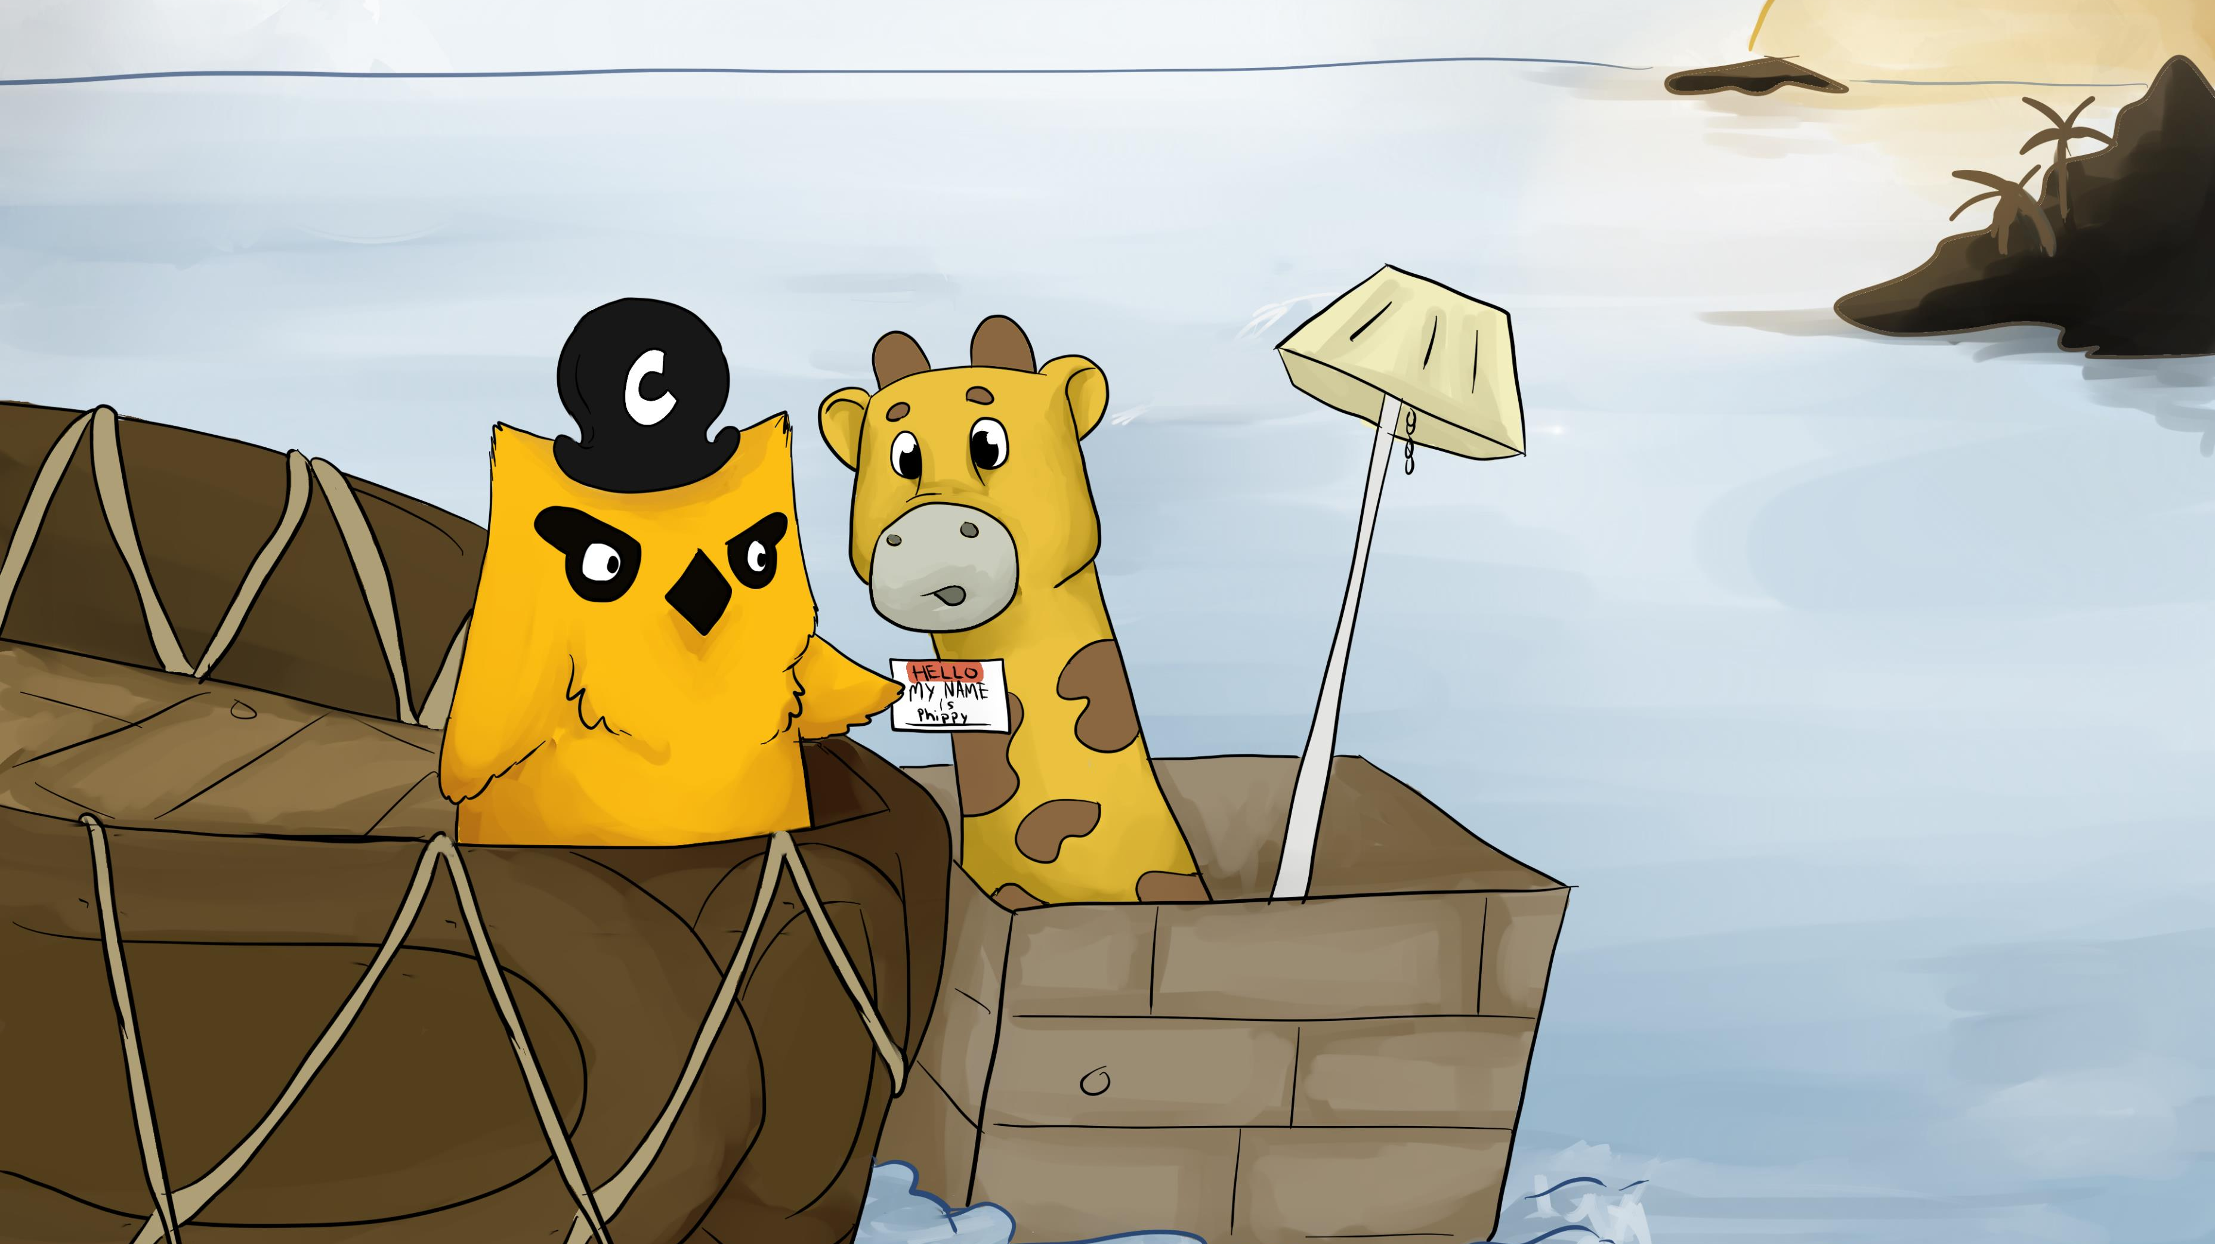
Notes:
As the boat bumped up against Phippy’s container, Phippy introduced herself. “Hi, I’m Phippy!” said the little app.
“Nice to make your acquaintance,” said the captain as he slapped a name tag on Phippy – an awkward way to greet someone for the first time.

Slide 10
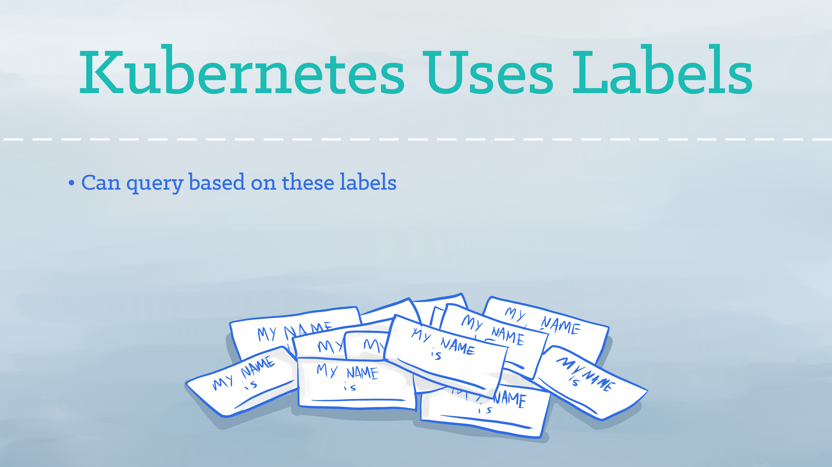
Notes:
Kubernetes uses labels as “name tags” to identify things. Labels can be whatever you would like. You can use them to indicate the role of a container, its criticality, or other essential attributes.

Slide 11
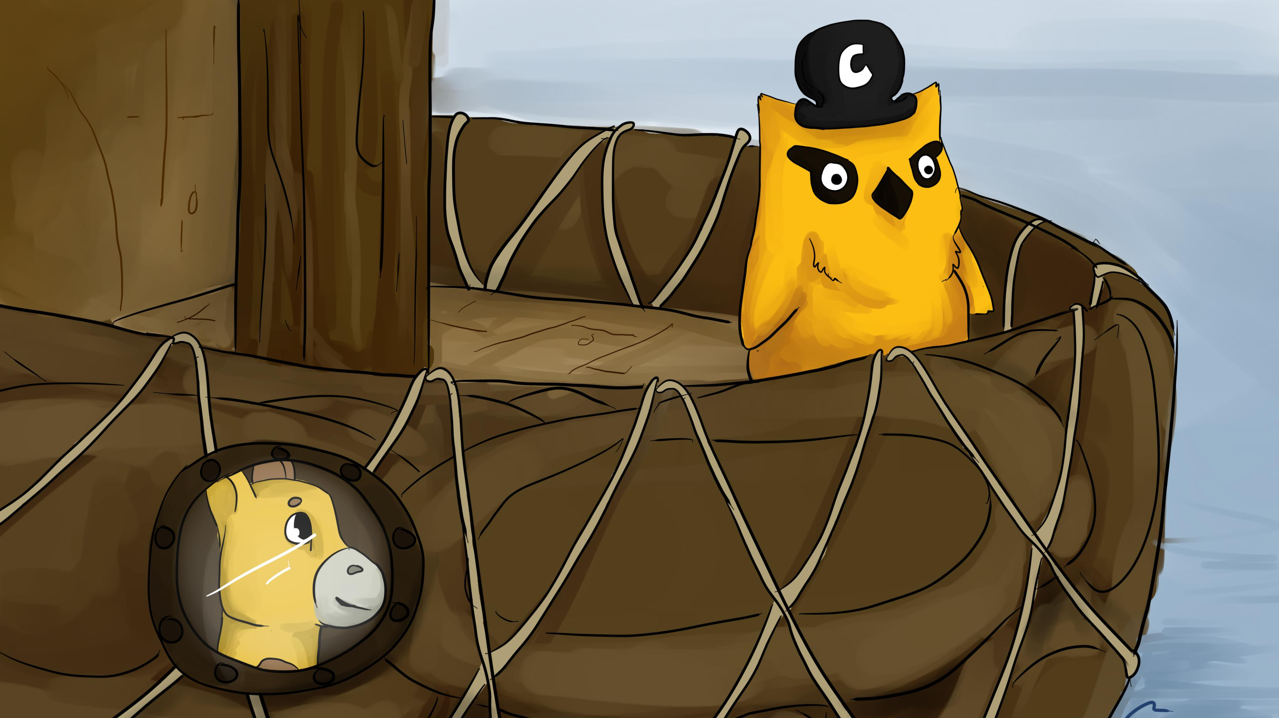
Notes:
Captain Kube suggested that the little app might like to move her container to a pod onboard his ship. Phippy happily agreed and Captain Kube helped her moved her container aboard. For the first time in a long time, Phippy felt at home.

Slide 12
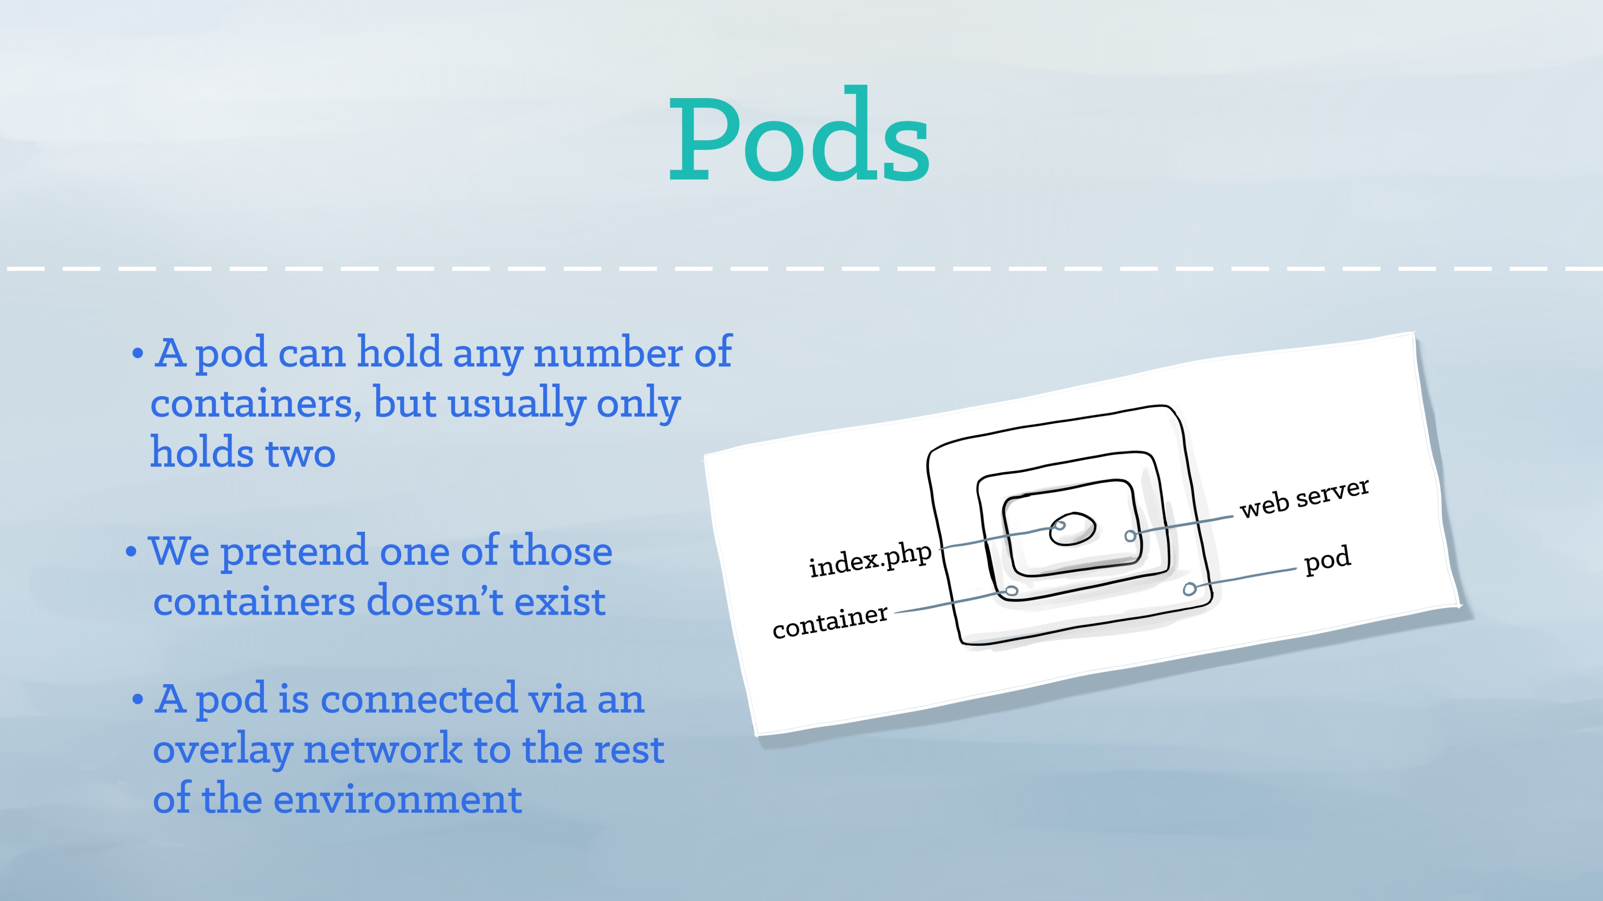
Notes:
A pod represents a runnable unit of work. Usually, a pod only runs a single container. But for cases where a few containers work better when right next to each other, you may opt to run more than one container inside of the same pod. Kubernetes takes on the work of connecting your pod to the network and the rest of the Kubernetes environment. Similarly, Captain Kube helped Phippy move her container onto his ship and ensured that she had access to a porthole to see outside.

Slide 13
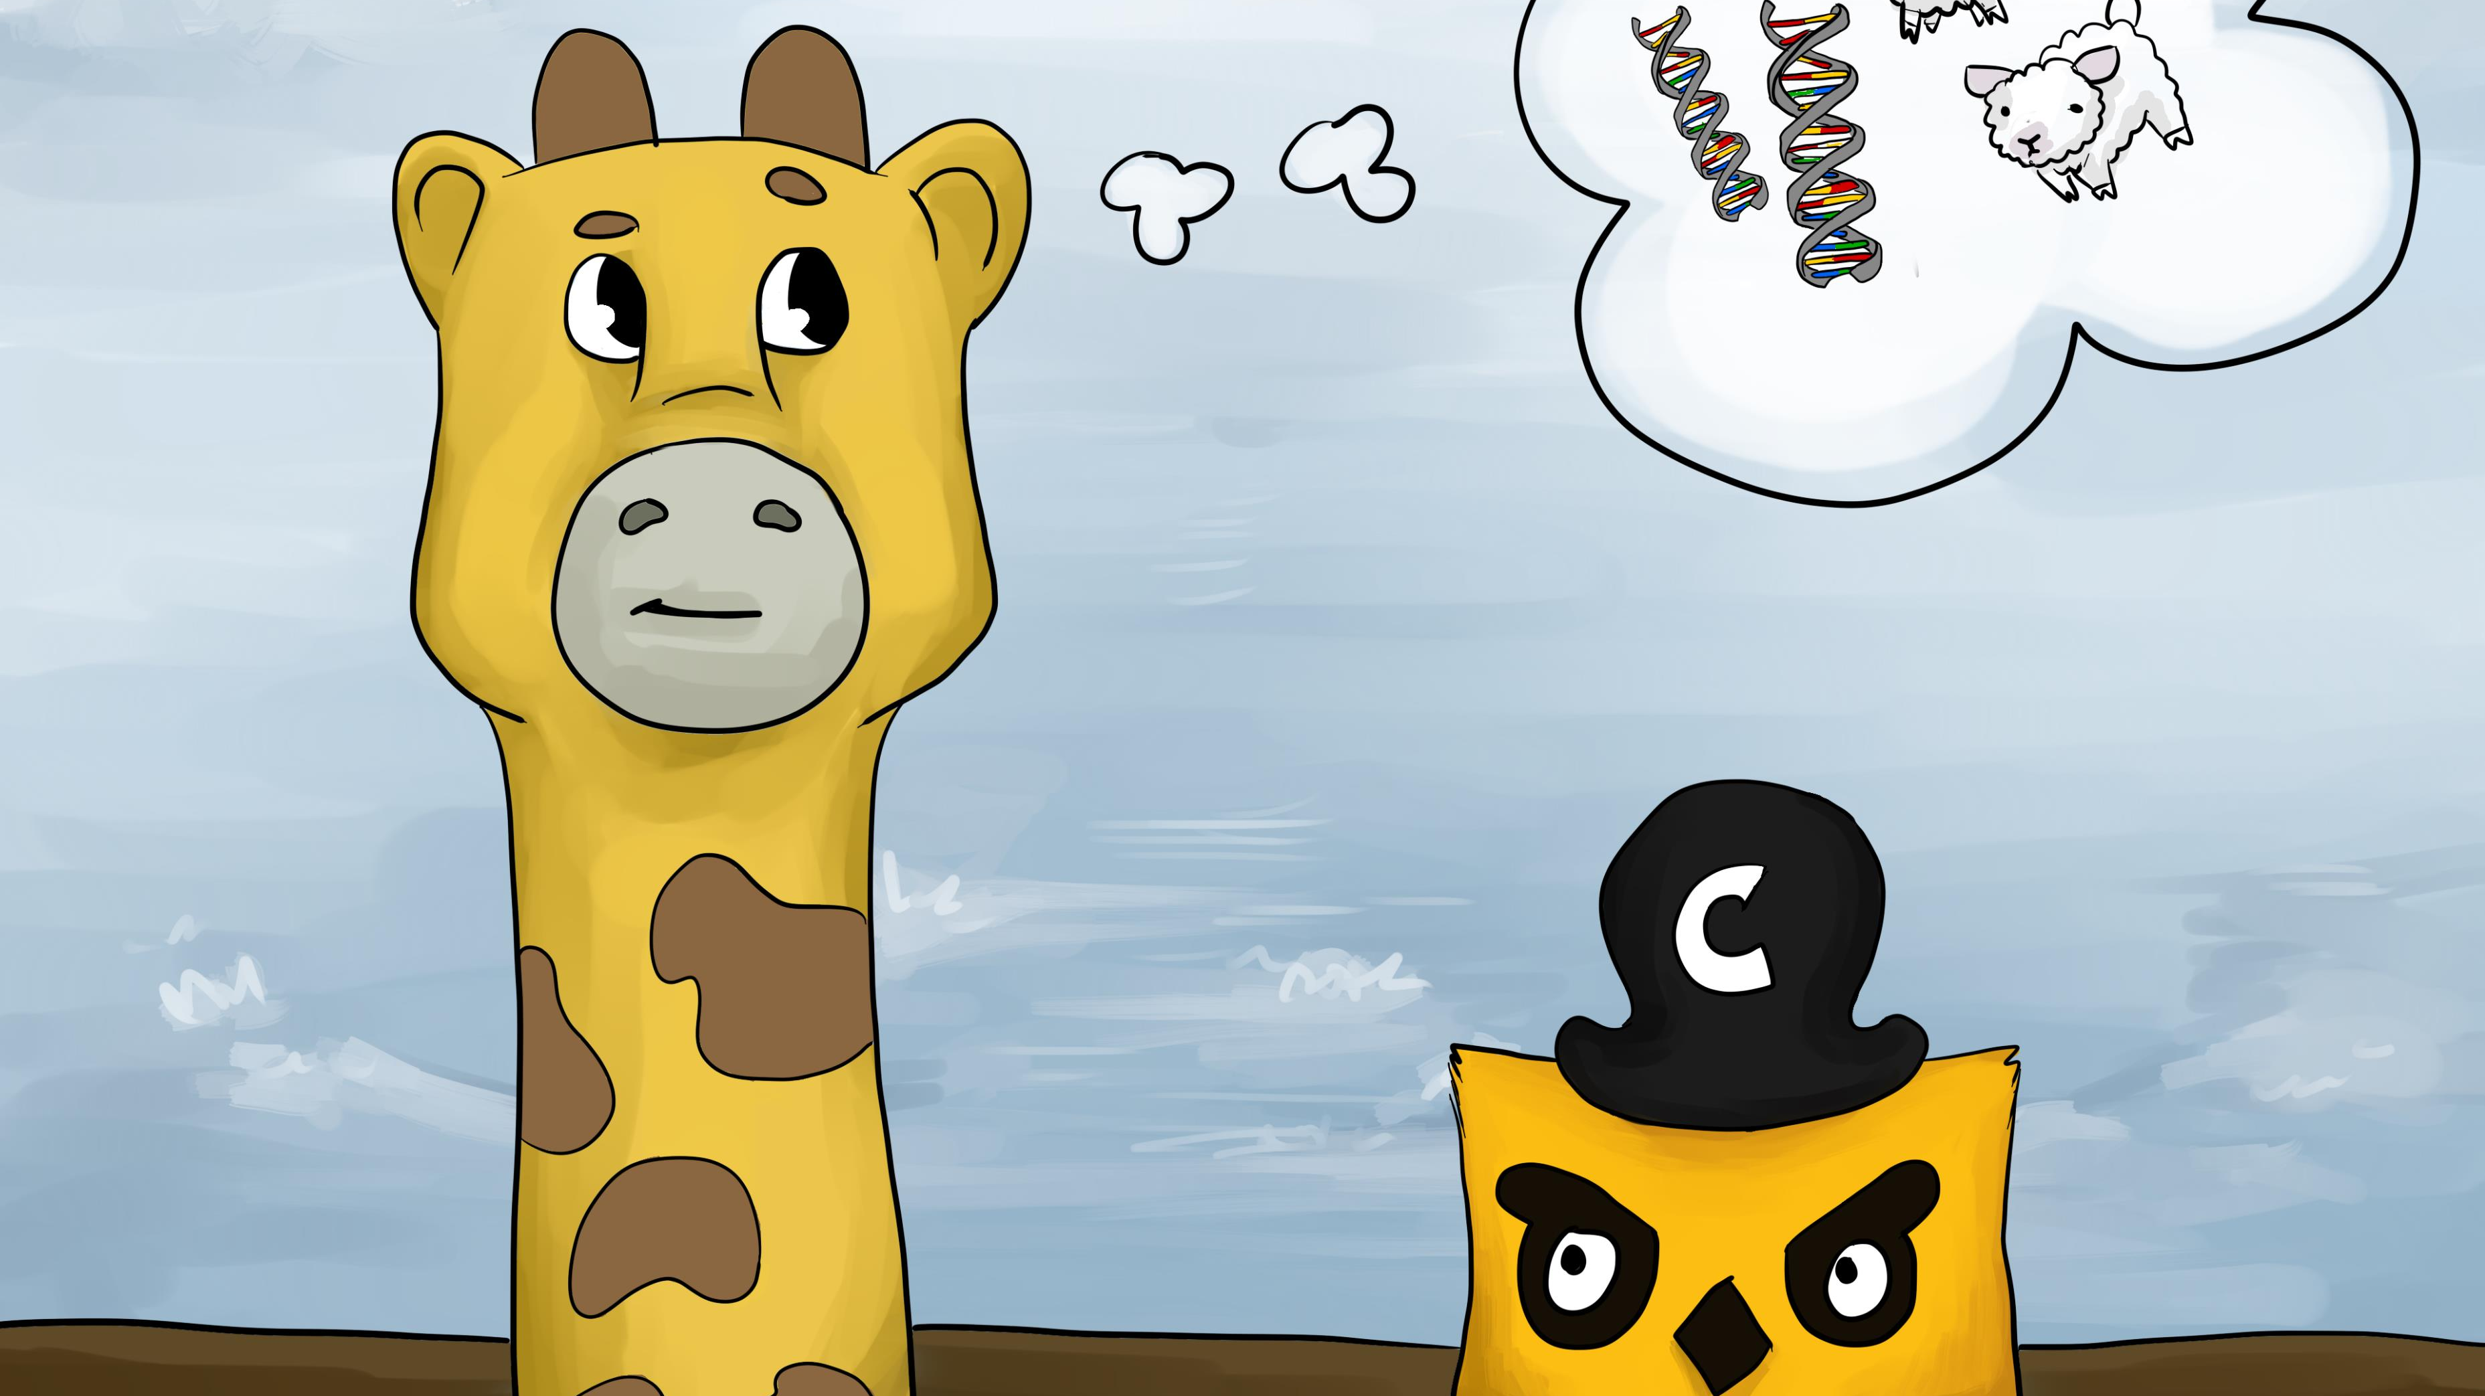
Notes:
Phippy was bored and had unusual interests, such as genetics and sheep. She asked Captain Kube, “Do you have any ideas about how I might clone myself, on-demand, any number of times?”
After checking international laws governing this sort of thing, the captain said, “That’s easy,” and he introduced her to ReplicaSets.

Slide 14
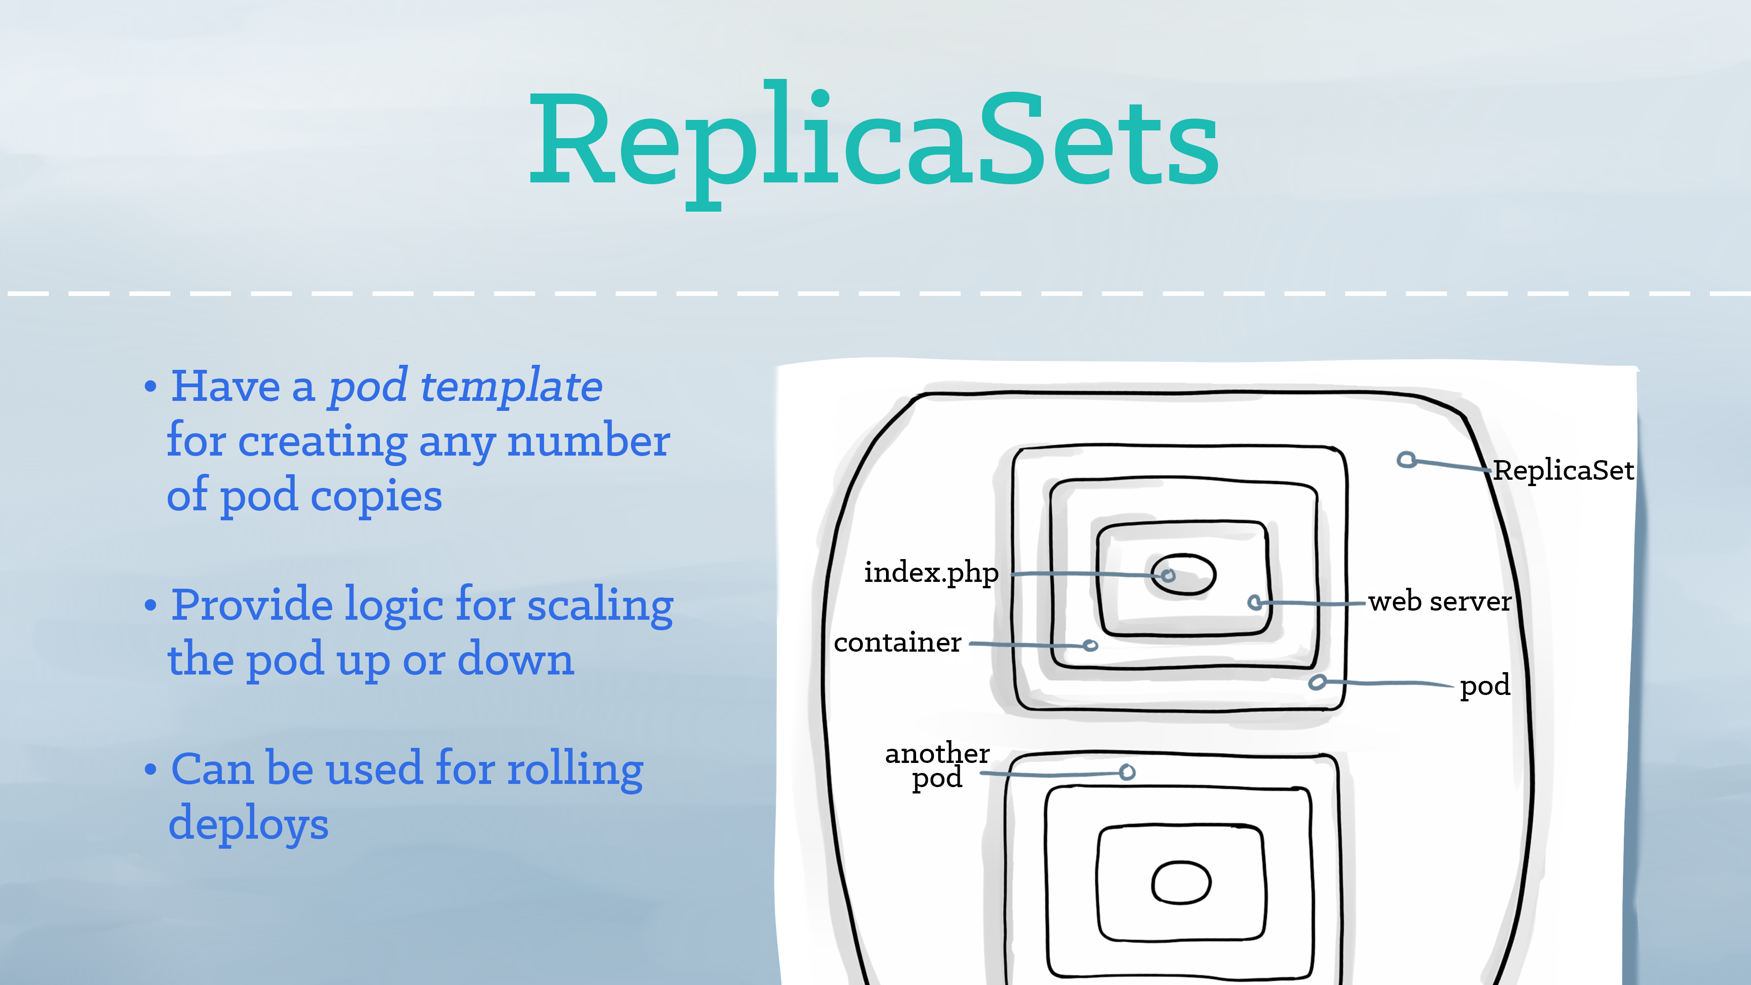
Notes:
ReplicaSets provide a method for managing an arbitrary number of pods. A ReplicaSet contains a pod template, which Kubernetes can replicate any number of times. Through the ReplicaSet, Kubernetes takes care of your pods’ lifecycle. That means that if you need more than one Phippy, or one Phippy awake at any time while others are napping, or if you need to keep an eye on your Phippys, ReplicaSets can do this for you.

Slide 15
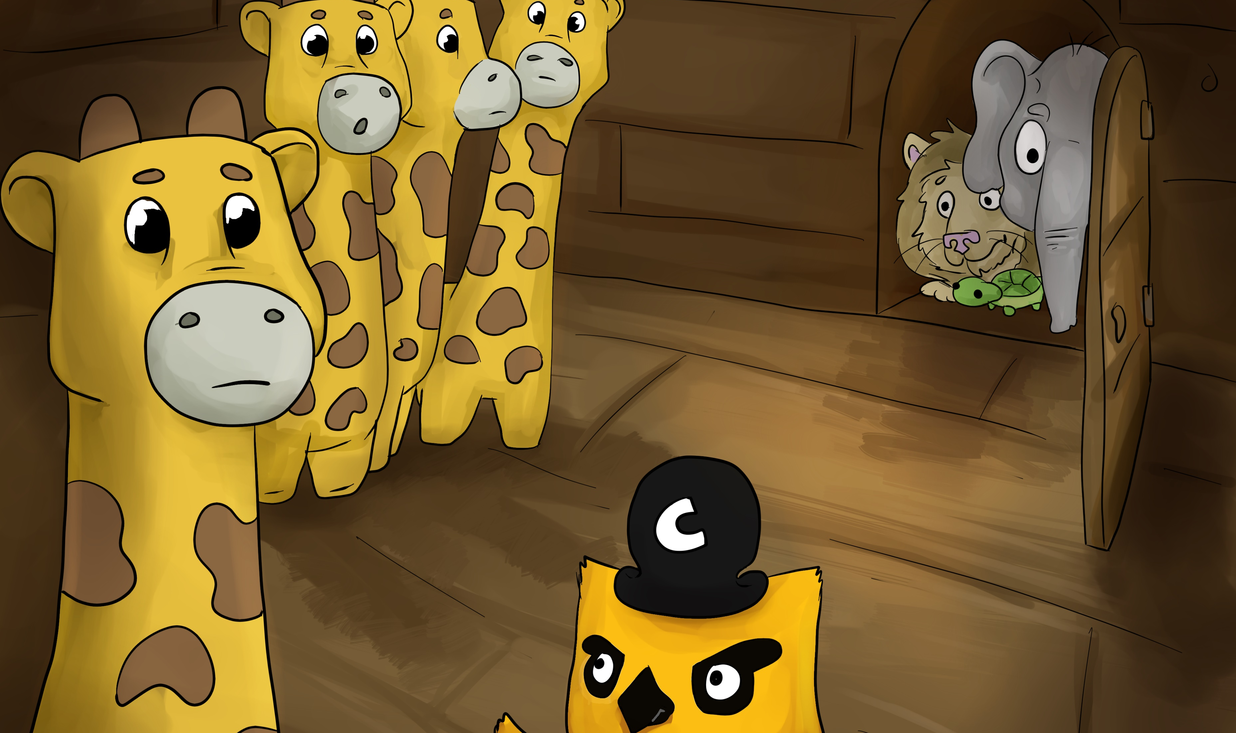
Notes:
For many days and nights, the little app was happy with her pod and her replicas. But, only having yourself to keep you company is not ideal, even if there are three copies of yourself.
Captain Kube smiled kindly and said, “I have just the thing.”
No sooner had he spoken than a tunnel opened between Phippy’s room and the rest of the ship. With a hearty laugh, Captain Kube said, “Even when your clones come and go, this tunnel will stay here so that you can discover other pods, and they can discover you!”

Slide 16
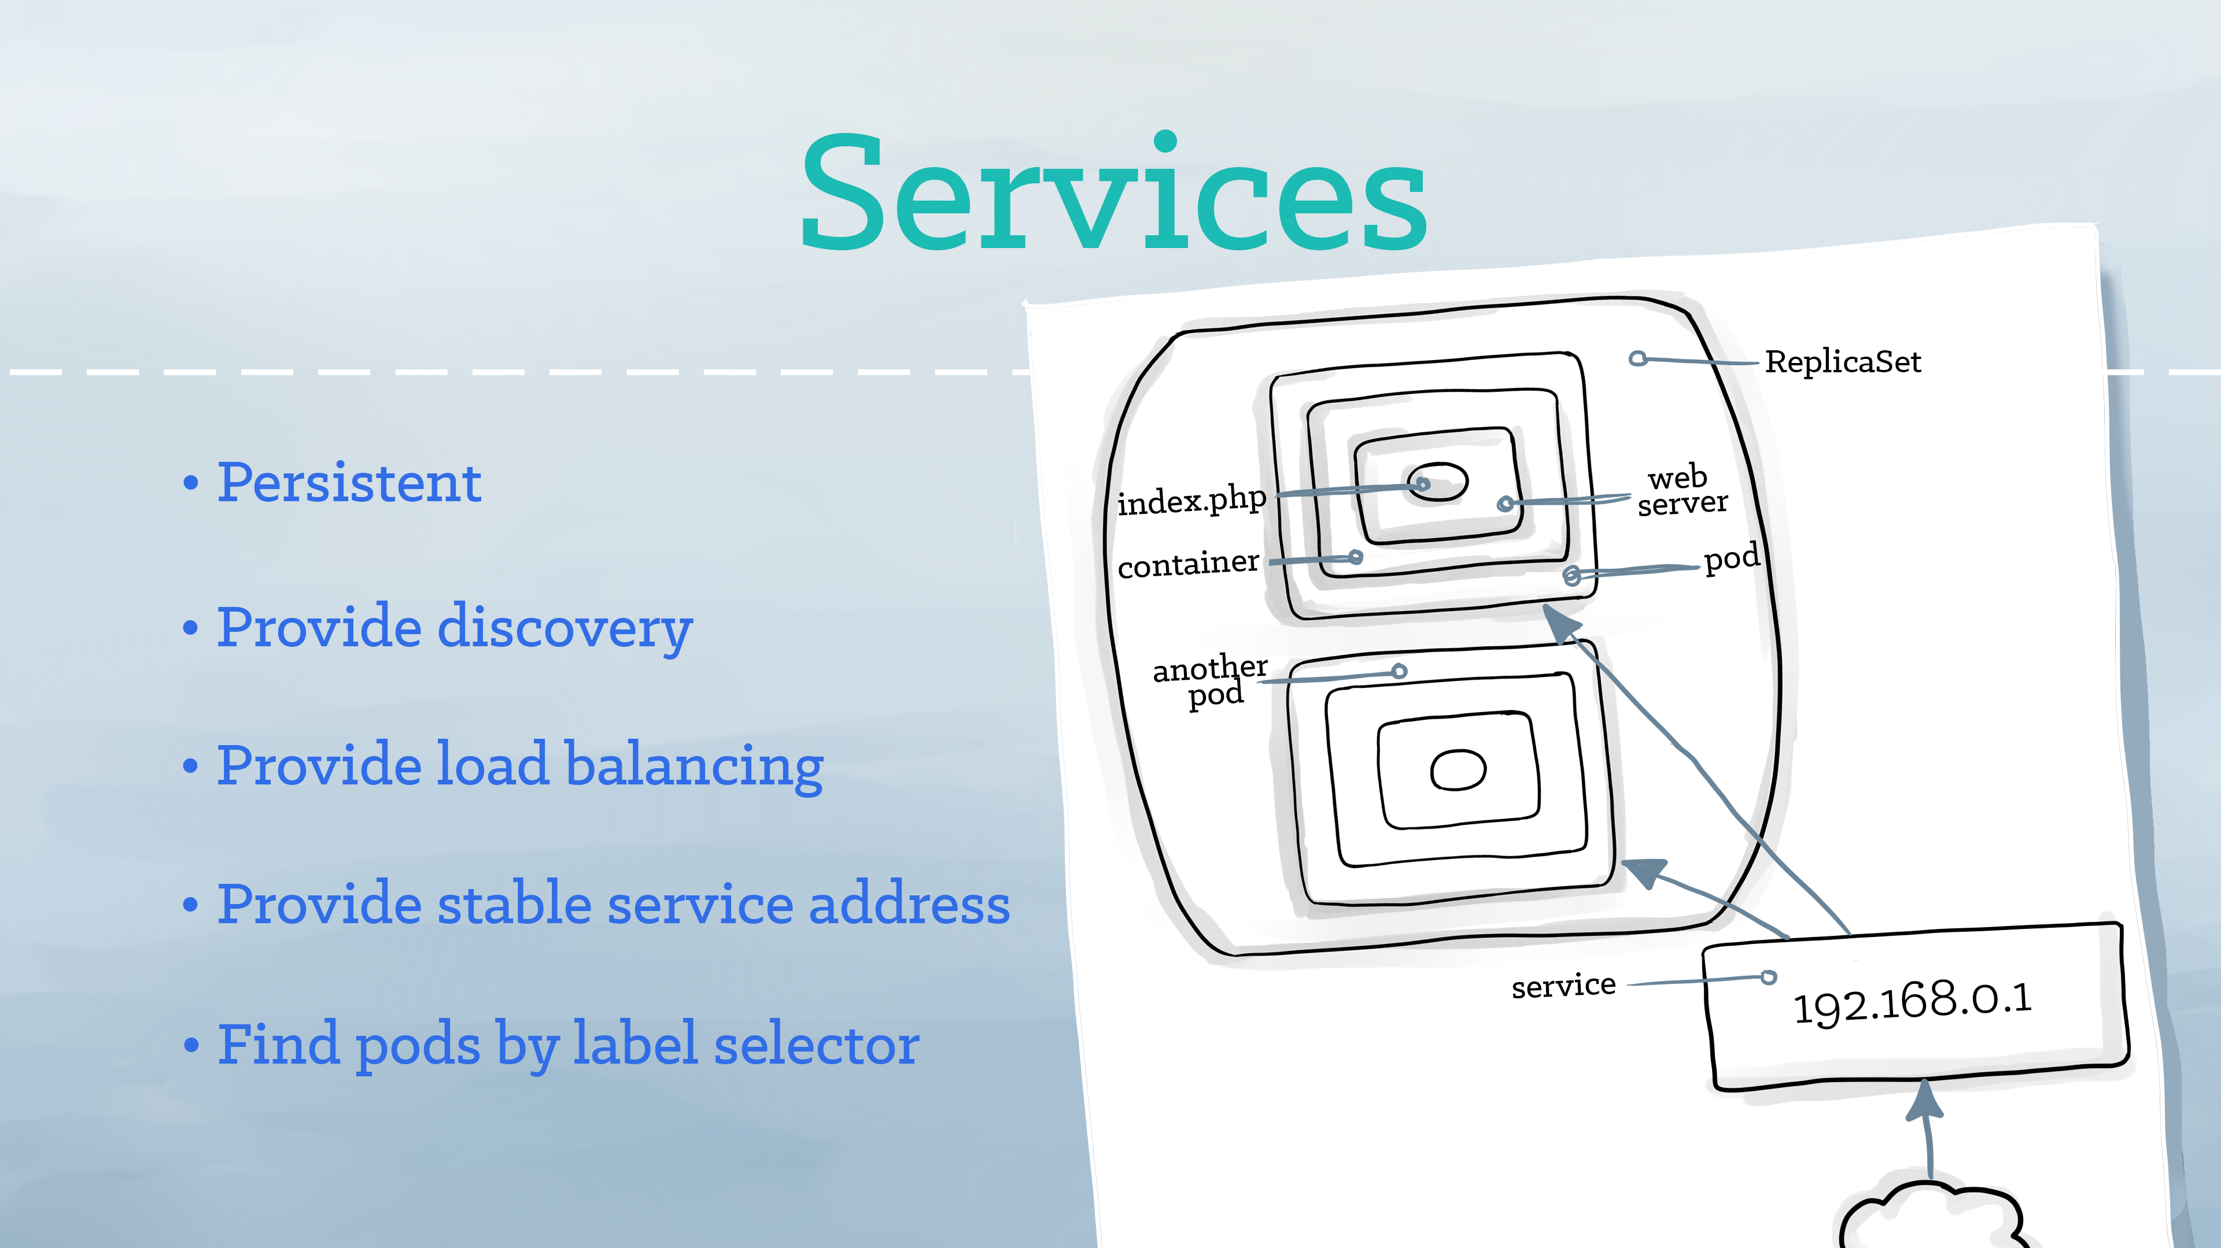
Notes:
A service tells the rest of the Kubernetes environment (including other pods and ReplicaSets) what services your application provides. It’s like Phippy and her replicas having a sign on their door that read, “Cute PHP app.” While pods come and go, the service’s IP addresses and ports remain the same. Other applications can find your service through Kubernetes service discovery.

Slide 17
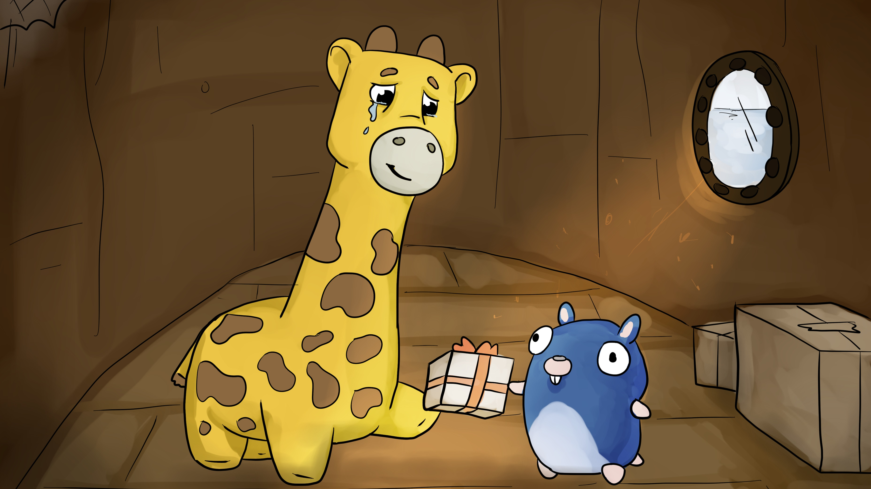
Notes:
Phippy began to explore the rest of the ship. It was not long before Phippy met Goldie, and they became the best of friends. One day, Goldie did something extraordinary: she gave Phippy a present! Phippy took one look, and the saddest of sad tears escaped her eye.
“Why are you so sad?” asked Goldie.
“I love the present, but I have nowhere to put it!” sniffed Phippy.
But Goldie knew what to do. “Why not put it in a volume?”

Slide 18
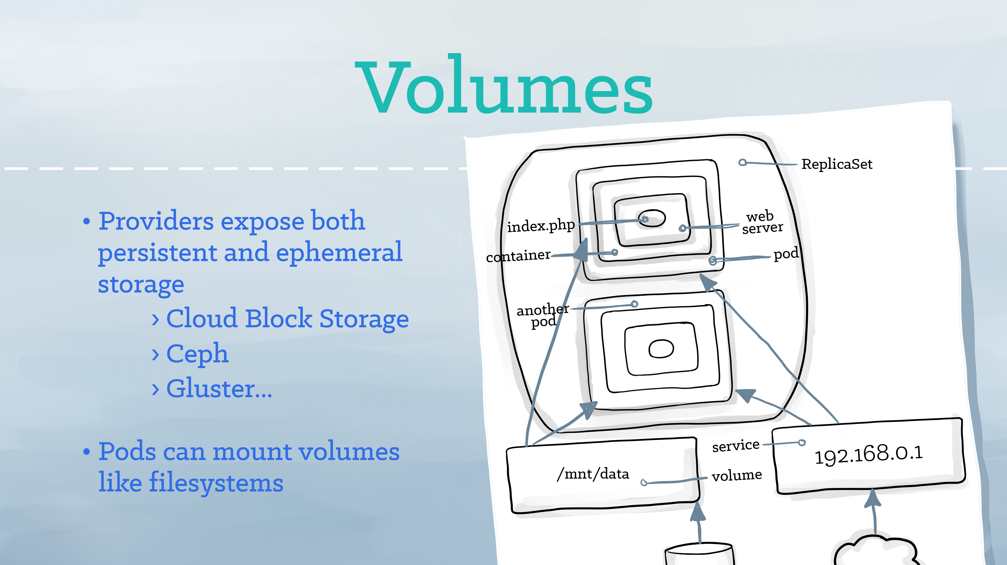
Notes:
A volume represents a location where containers can access and store information. A volume appears to the app as part of the local file system. Volumes may be backed by local storage, Ceph, Gluster, cloud block storage, or several other storage backends. Phippy’s volume is a treasure chest, kept in her room on Captain Kube’s ship.

Slide 19
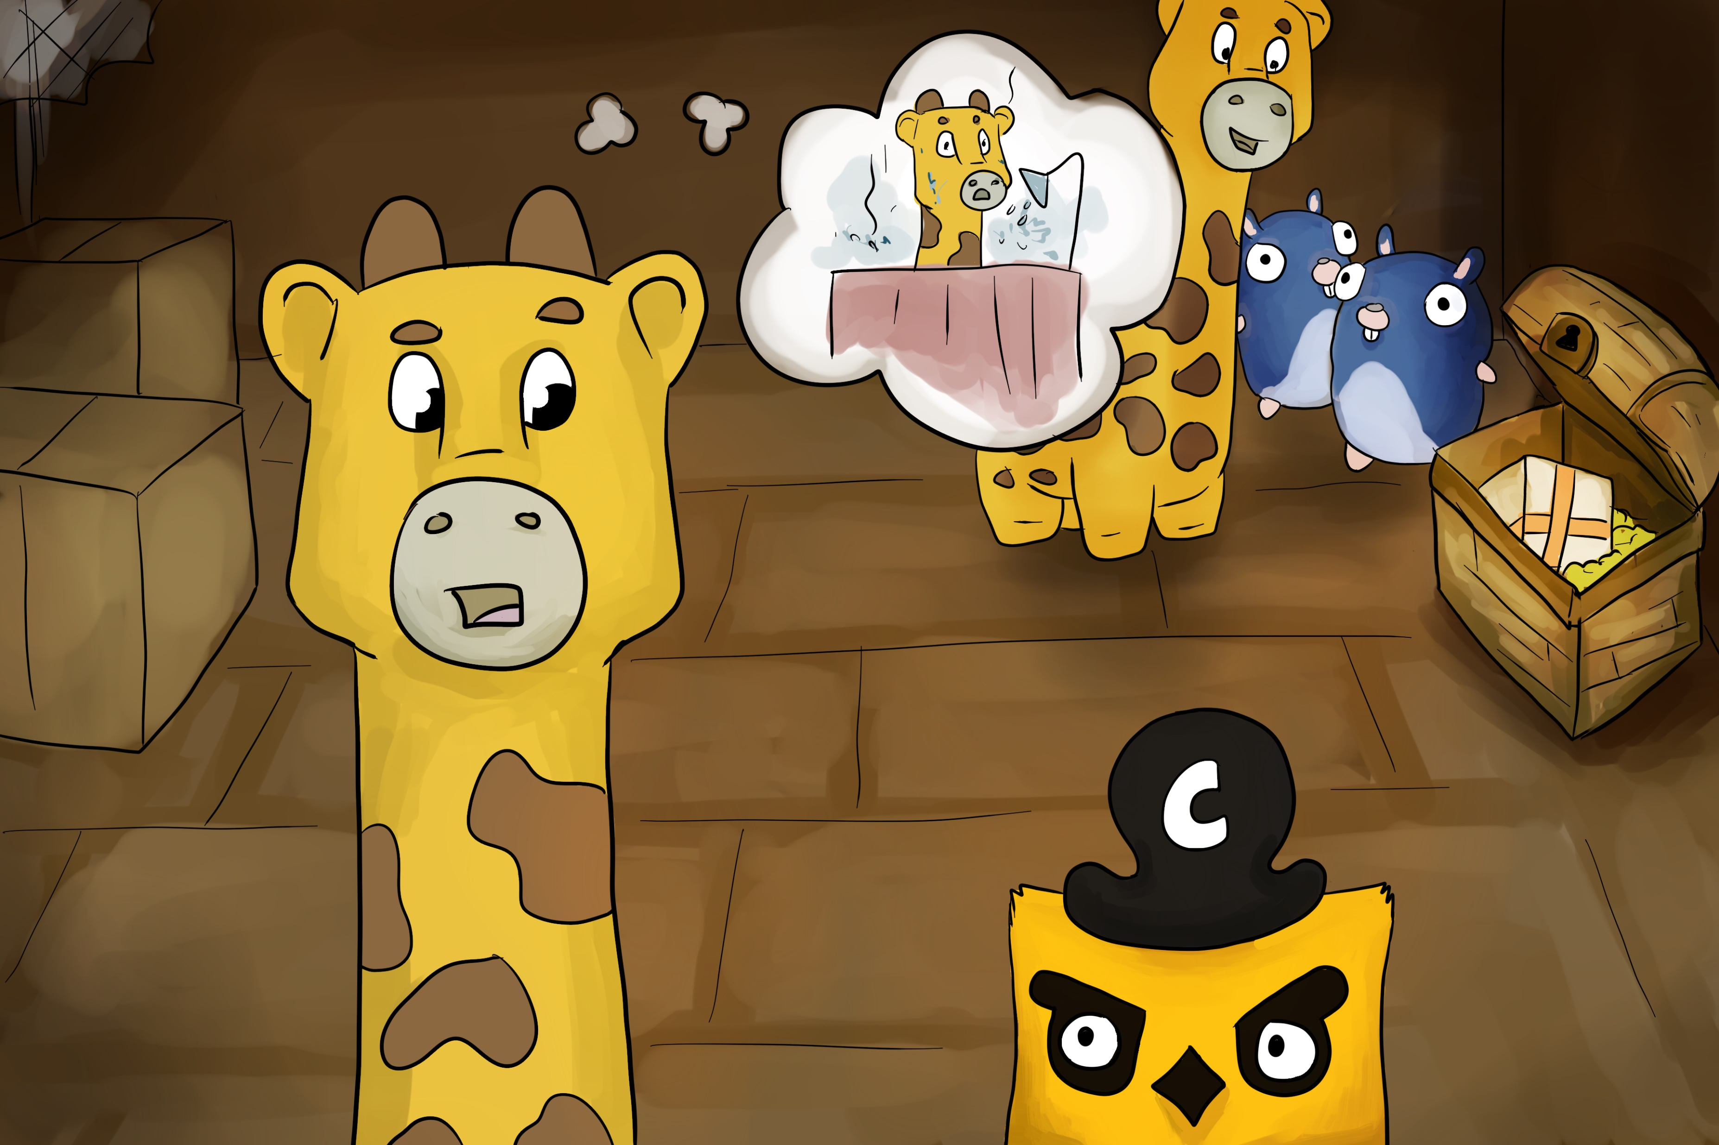
Notes:
Phippy loved life aboard Captain Kube’s ship, and she enjoyed the company of her new friends (every replicated pod of Goldie was equally delightful). But as she thought back to her days on the scary hosting provider, she began to wonder if perhaps she could have a little privacy.
“It sounds like you need a namespace,” said Captain Kube.

Slide 20
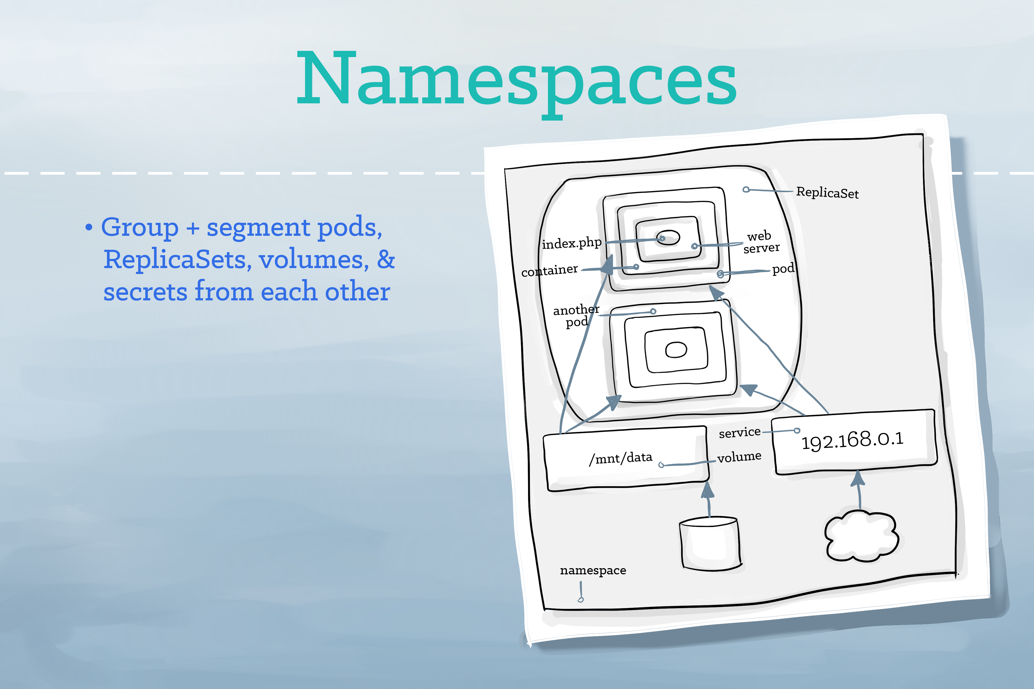
Notes:
A namespace is a grouping mechanism inside of Kubernetes. Services, pods, ReplicaSets, and volumes can easily cooperate within a namespace, and the namespace provides a degree of isolation from other parts of the cluster. Inside her namespace, Phippy can relax and take a hot shower.

Slide 21
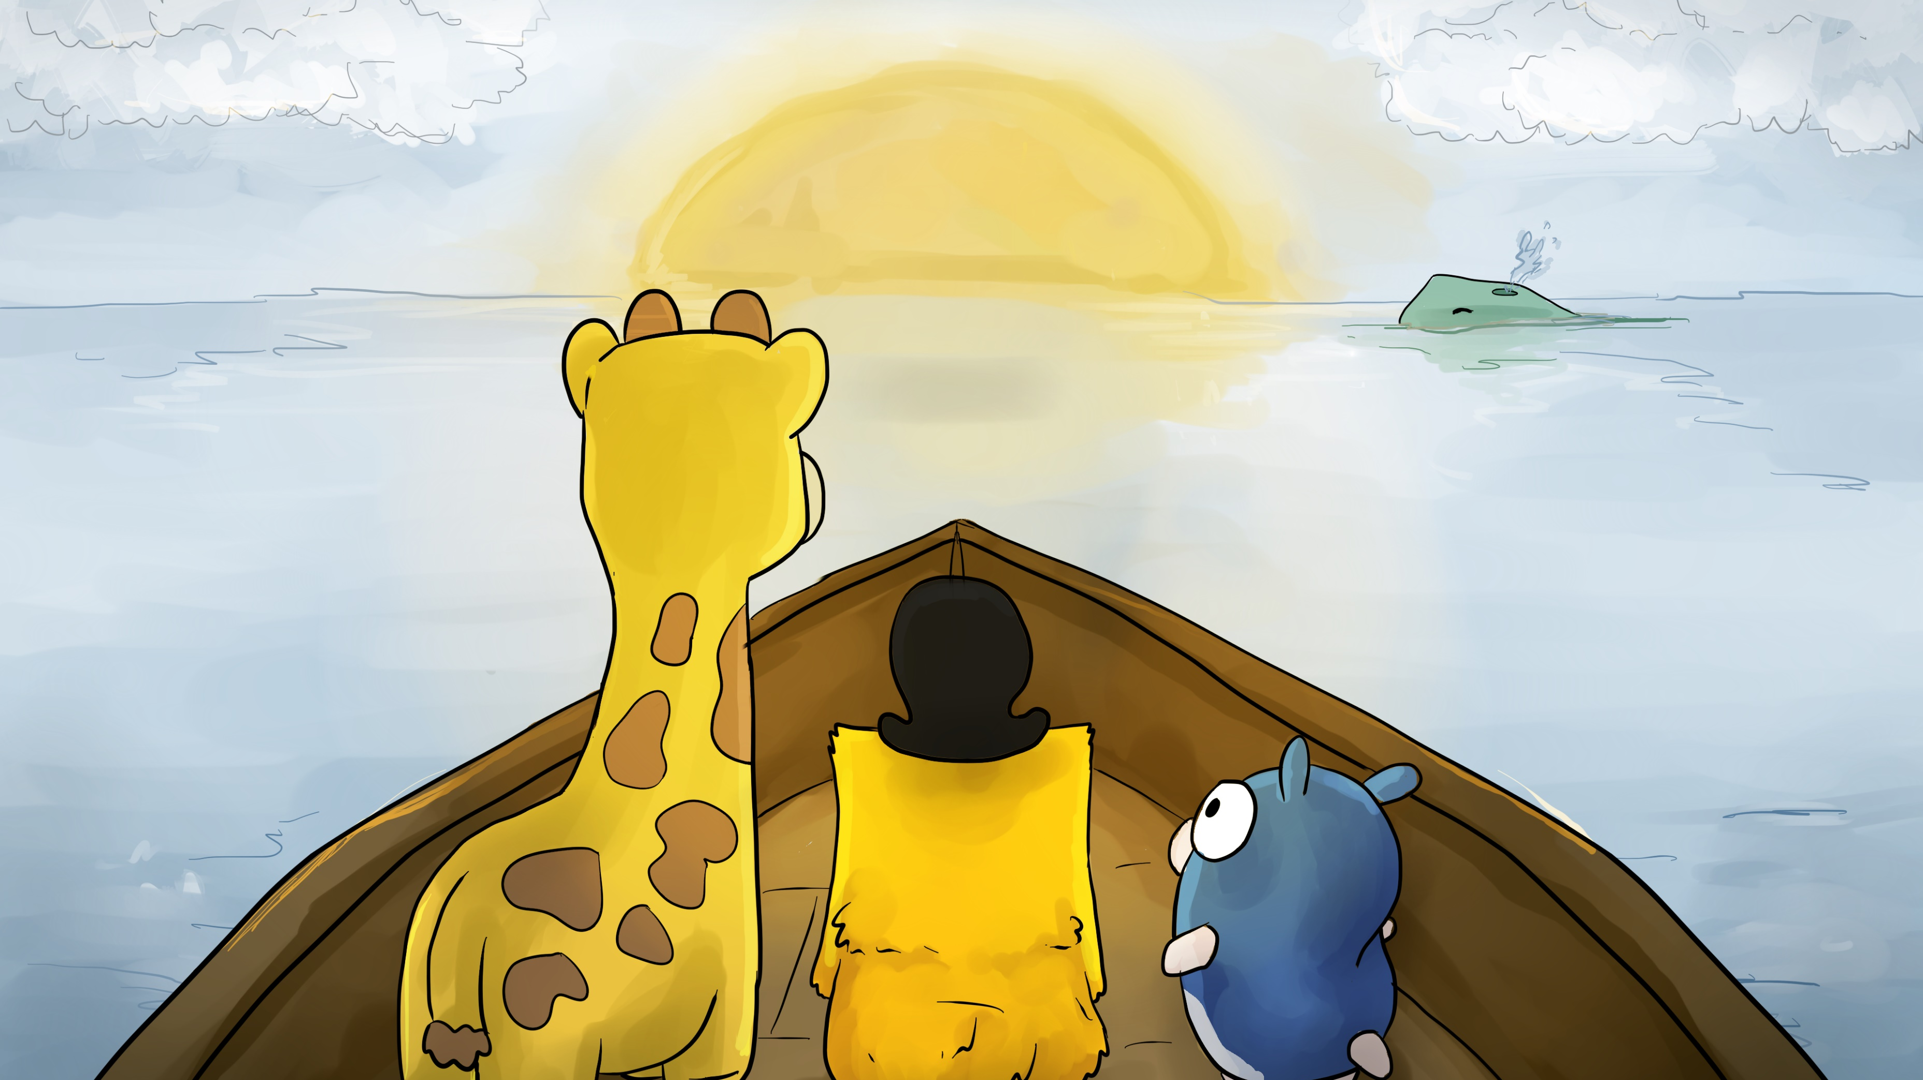
Notes:
Life was good aboard Captain Kube’s boat. Together with her new friends, Phippy sailed the seas. She had many grand adventures, but most importantly, Phippy had found her home.
And so, Phippy lived happily ever after.

Slide 22
Thanks!
For more Phippy, visit https://phippy.io
Writing and design modified by me (with permission): Frank Lesniak Twitter: @FrankLesniak LinkedIn: https://linkedin.com/in/flesniak
Story originally written by Matt Butcher
Illustrations by Bailey Beougher
Original design by Karen Chu
Licensed under Creative Commons Attribution 4.0 International (CC-BY-4.0). See https://phippy.io

